Slide 1
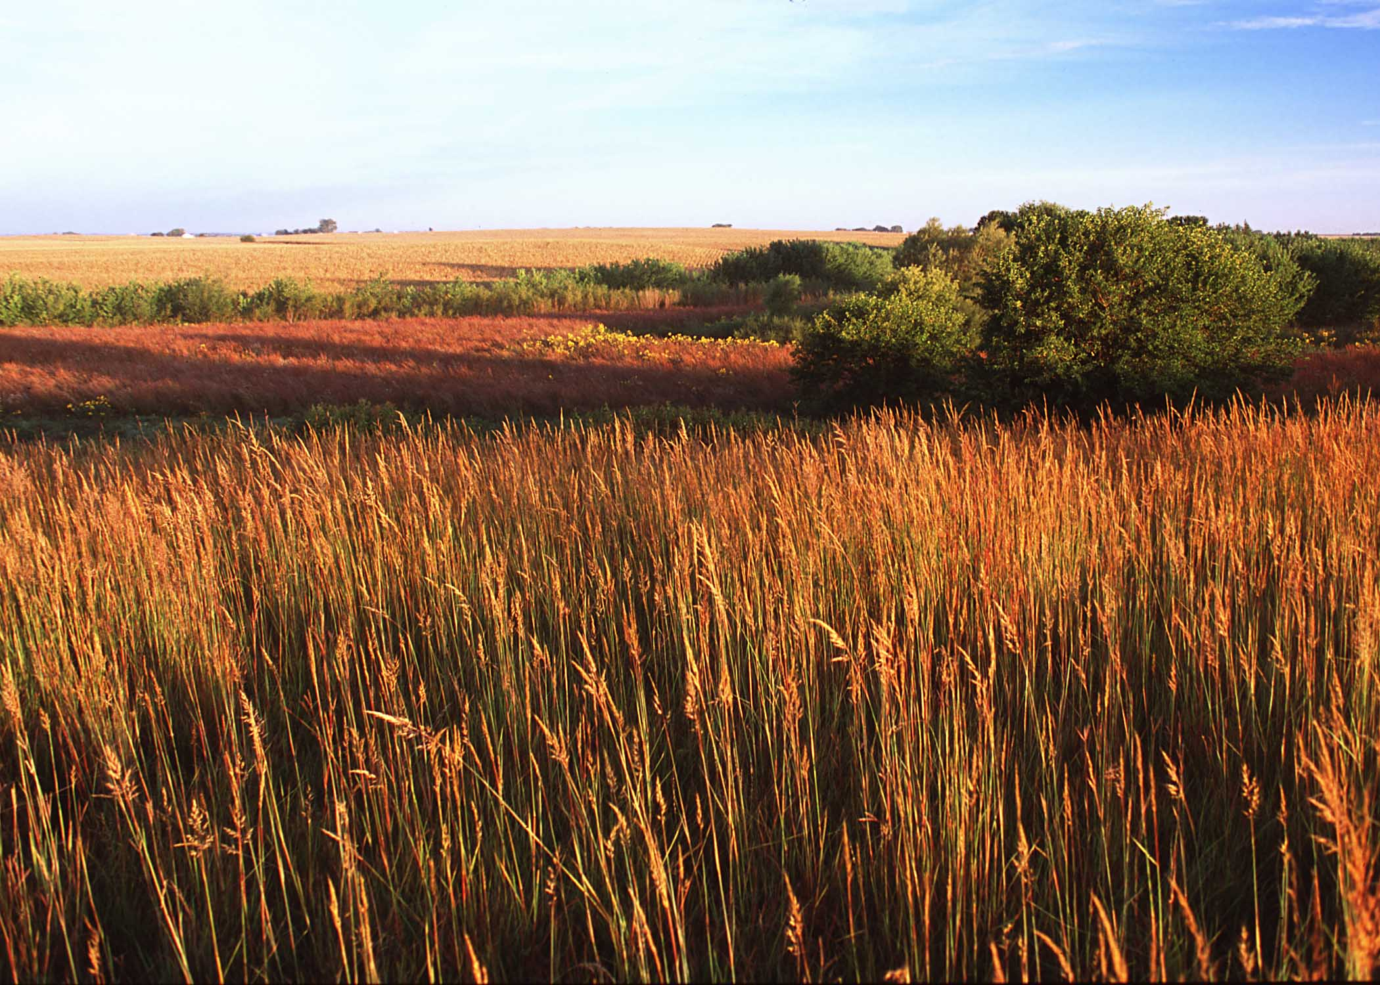
National Association of Conservation Districts
New Orleans – February 2, 2015
Why Farmers and Environmentalists Need Each Other
Don Stuart
www.donstuart.net
Photo courtesy of USDA/NRCS

Slide 2
Photo courtesy of USDA/NRCS

Slide 3
Photo courtesy of USDA/NRCS
A Paradox for Farmers

Slide 4
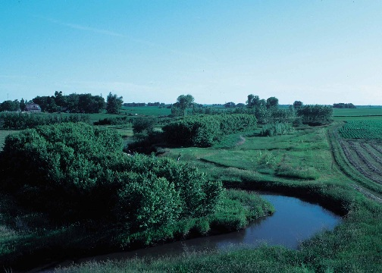
A Paradox – For Farmers
Incentives could reduce need for regulation
Deny problems
Incentives underfunded
Compromised effectiveness
Problems worsen
Drumbeat for regulation grows
Don Stuart
www.donstuart.net

Slide 5
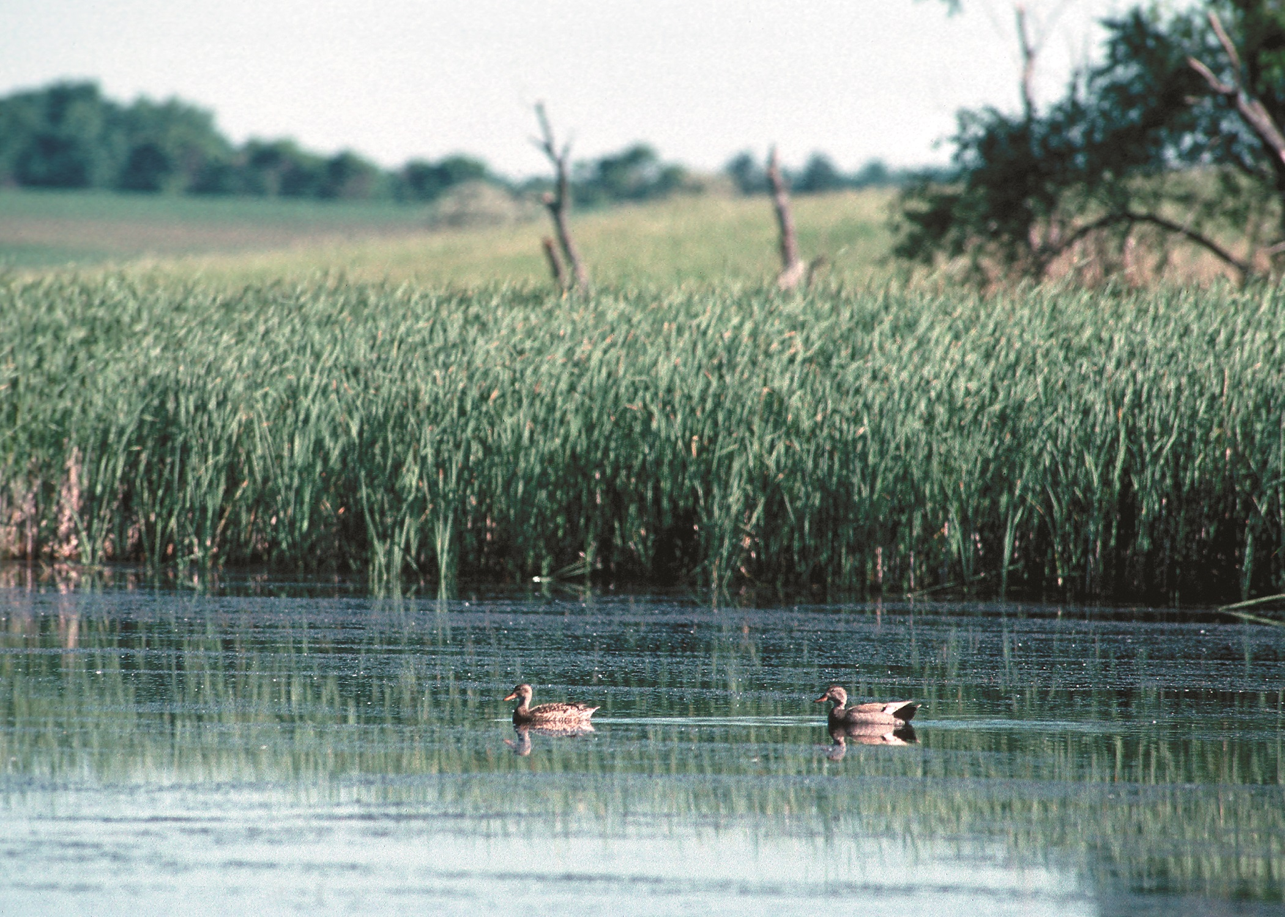
Photo courtesy of USDA/NRCS
A Paradox for Environmentalists

Slide 6
A Paradox – For Environmentalists
Regulations can accelerate farm loss
Harmful development
Lost mitigation and lift
Cannot acknowledge alternative solutions
Regulations victim of stalemate
Problems worsen
Don Stuart
www.donstuart.net

Slide 7
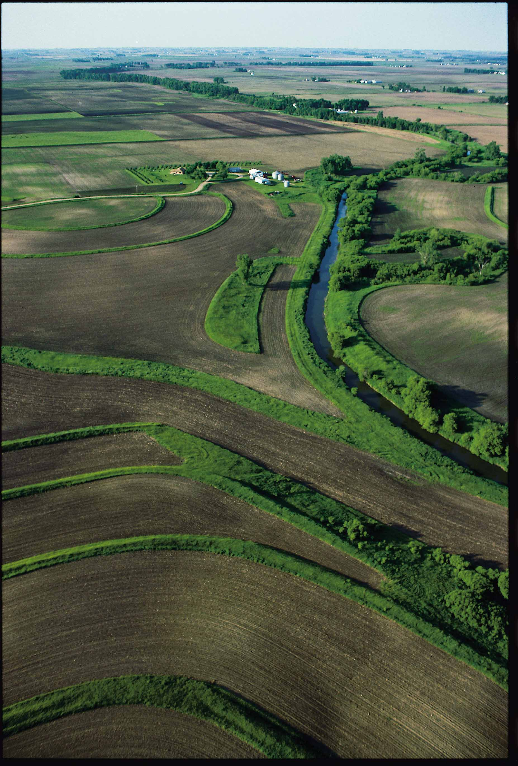
Photo courtesy of USDA/NRCS
Overview

Slide 8
Overview
Building blocks in the Case for Cooperation
3 Steps in a Modest Proposal
Two Visions of the Future
Don Stuart
www.donstuart.net

Slide 9
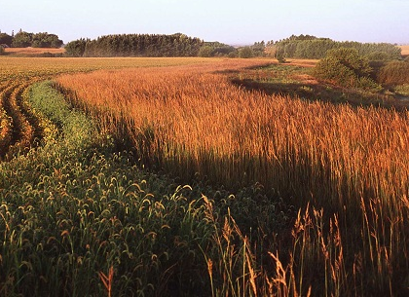
An Inevitable Relationship
Photo courtesy of USDA/NRCS

Slide 10
The Case for Cooperation: An Inevitable Farmer- Environmentalist Relationship
2 million farms in U.S.
50% of U.S. land base in agriculture
Farms use 80% of nation’s fresh water
Profound impacts on the environment
Will they fight or will they cooperate?
Don Stuart
www.donstuart.net

Slide 11
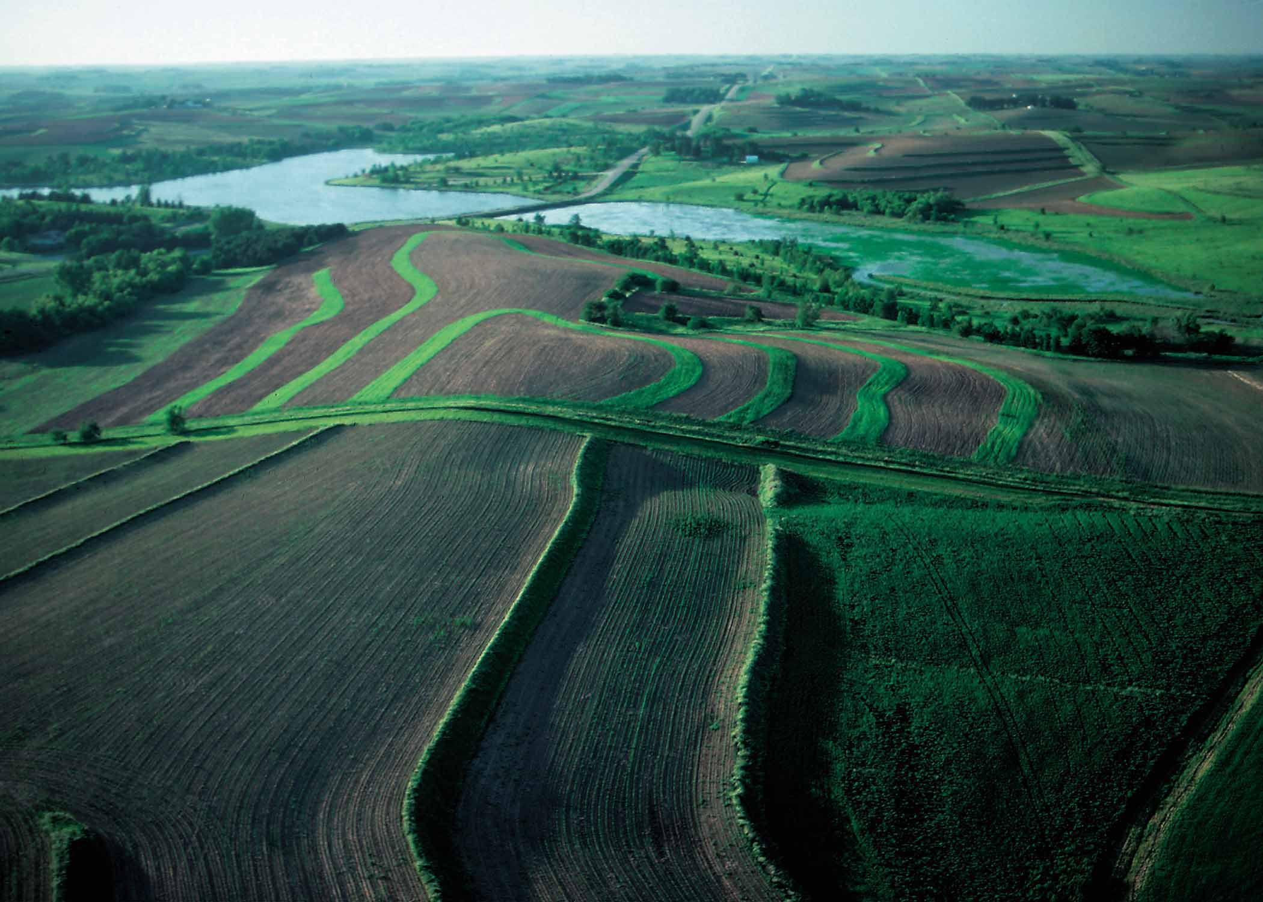
Ag’s Environmental Risks
Photo courtesy of USDA/NRCS

Slide 12
The Case for Cooperation: Agriculture’s Environmental Risks
Water Quality:
Runoff of nutrients, pesticides, and sediment
Air Quality:
Climate impacts from fertilizers & livestock methane
Wildlife Habitat:
Displaced wildlife, blocked migration, fish habitat
Human Health:
E-coli, pesticides
Don Stuart
www.donstuart.net

Slide 13
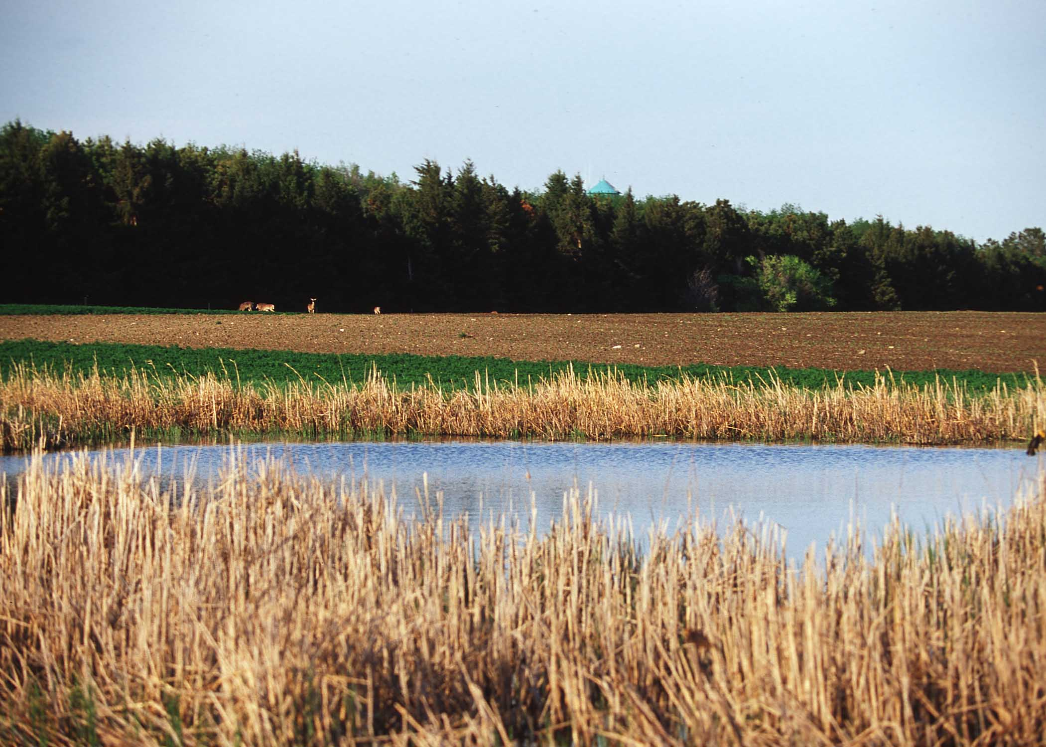
Farms Vulnerable to Regulation
Photo courtesy of USDA/NRCS

Slide 14
The Case for Cooperation: Farm Vulnerability to Regulation
Ag can be regulated
Farm practice legislation
Unique landscapes, crops, and circumstances
Small, family businesses
Multinational food conglomerates
Unforgiving Global marketplace
Don Stuart
www.donstuart.net

Slide 15
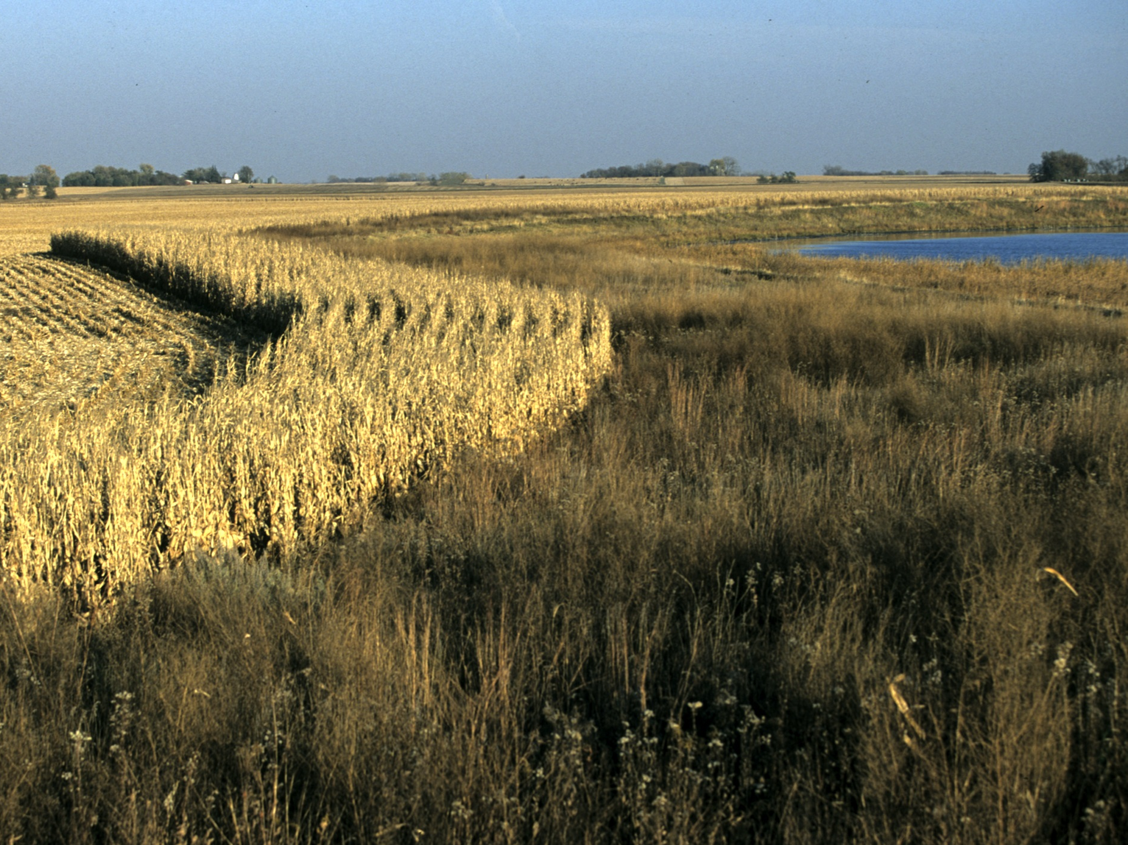
Lost Farms – Degraded Environment
Photo courtesy of USDA/NRCS

Slide 16
The Case for Cooperation: When Farms Disappear: Degraded Environment
Urban water pollution
Diminished plant uptake of surface water pollutants
Greenhouse gasses from lost vegetative cover and increased transportation
Lost aquifer recharge
Increased flooding
Lost wildlife habitat
Don Stuart
www.donstuart.net

Slide 17
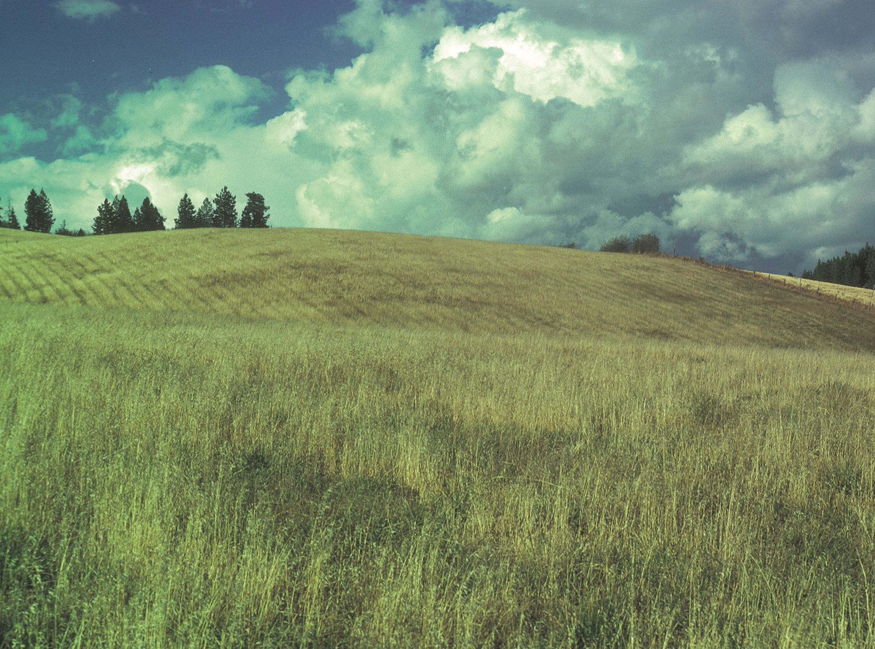
Lost Farms – Mitigation & Lift
Photo courtesy of USDA/NRCS
Photo courtesy of USDA/NRCS

Slide 18
The Case for Cooperation: When Farms Disappear: Lost Opportunities for Mitigation and Lift
Water quality
Crop rotation, contour farming, buffer strips, cover crops
Greenhouse gas offsets
No till, precision ag, anaerobic digesters, vegetation of uncultivated areas
Fish & wildlife habitat
Buffers & wetlands in uncultivated areas, fence line openings, wildlife cover crops
Swans & dairies
Don Stuart
www.donstuart.net

Slide 19
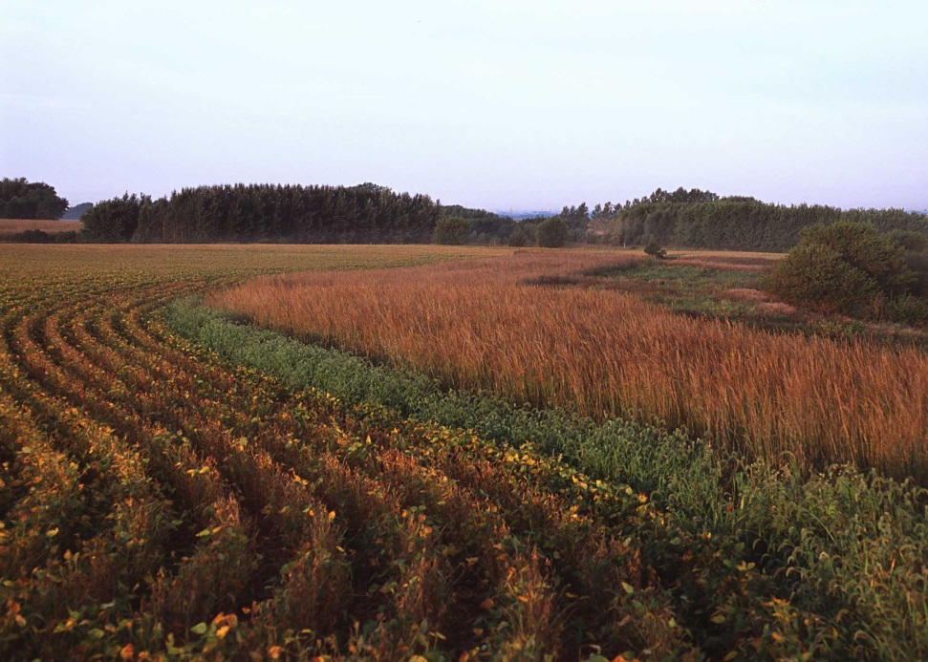
Array of Solutions
Photo courtesy of USDA/NRCS

Slide 20
The Case for Cooperation: An Impressive Array of Solutions
Practice rules
Zoning
Conservation Incentives
Conservation Economics
Environmental Markets
Consumer Marketplace
Purchase Dev. Rights
Economic Viability
Two Categories - Voluntary - Involuntary
Don Stuart
www.donstuart.net

Slide 21
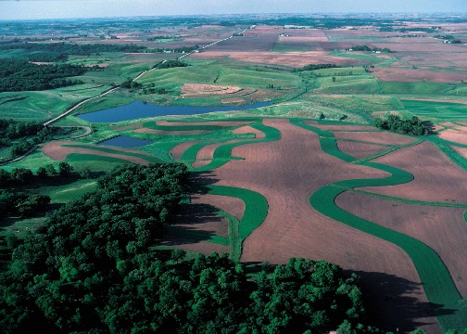
Role of Fairness
Photo courtesy of USDA/NRCS

Slide 22
The Case for Cooperation: The Role of Fairness
Nobody likes to be a patsy
Whatever we do will cost someone something
Incentives place burden on public
Regulation places burden on regulated industry
Need for reasoned allocation of burden of the fix
Sense of fairness essential to securing political support for any solution
Lake WA Salmon habitat example
Don Stuart
www.donstuart.net

Slide 23
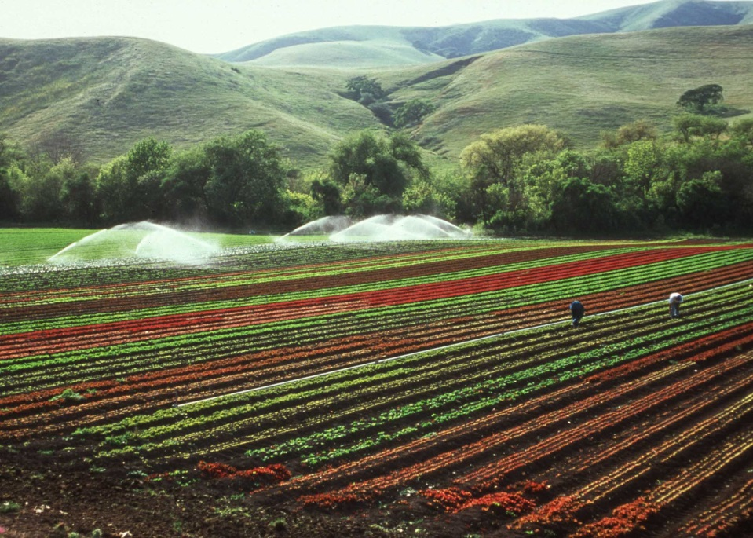
Photo courtesy of USDA/NRCS
Use Every Possible Tool

Slide 24
The Case for Cooperation: Use Every Possible Tool
Need all for fairness:
Some better for one group – some for another
Big problem - ignoring some solutions, increases burdens on the rest
Try everything to see what works
Need all to get support for any
Don Stuart
www.donstuart.net

Slide 25
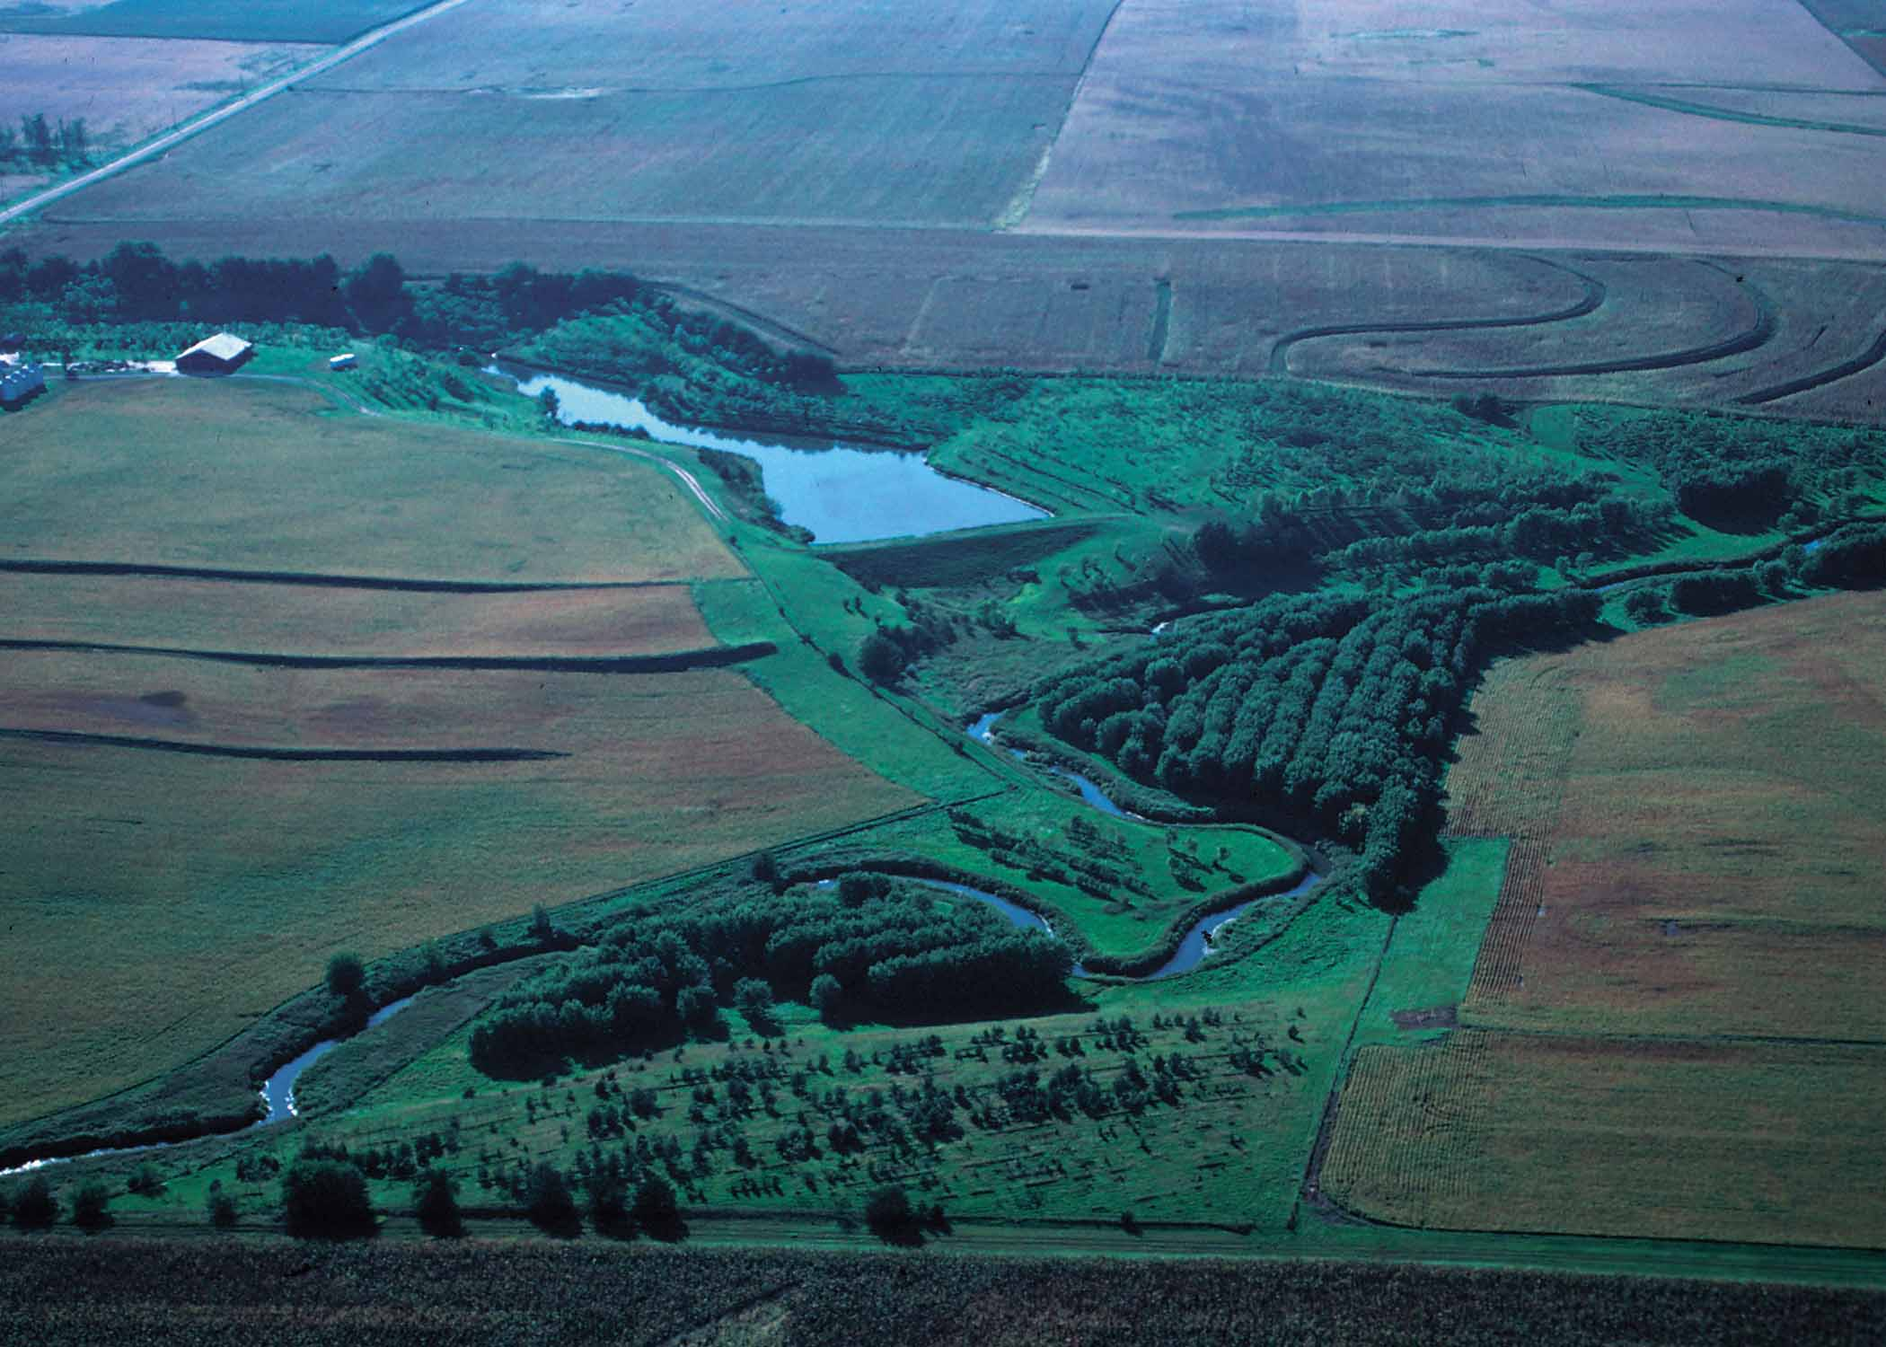
What is possible with cooperation
Photo courtesy of USDA/NRCS

Slide 26
What is Possible with Cooperation
An environment-friendly agriculture industry would be hugely helpful for the environment
Increased farmer conservation
Address critical issues strategically
Address sprawl, climate, water quality, aquifer recharge
A farm-friendly environmental community would be hugely helpful for agriculture
Support incentives and environmental markets
Limit regulatory threat
Enhanced public support for ag.
Don Stuart
www.donstuart.net

Slide 27
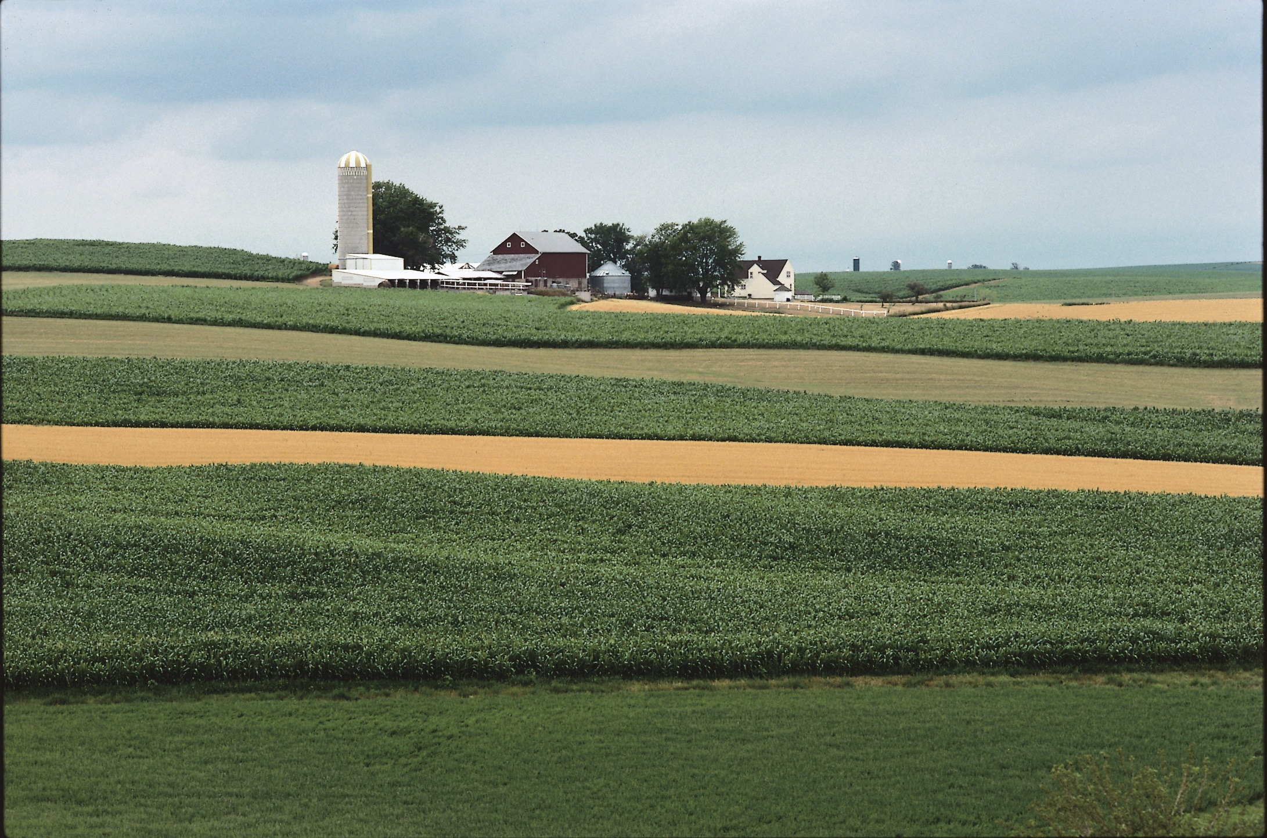
Solutions: Step 1 – Common Ground
Photo courtesy of USDA/NRCS

Slide 28
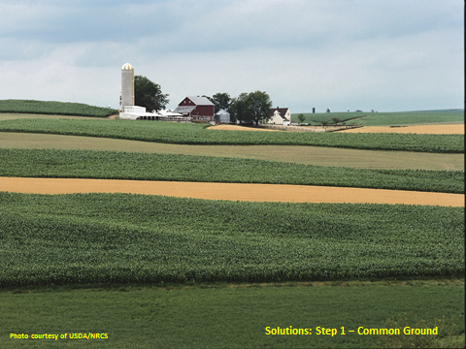
3 steps in a Modest Proposal: Step 1 - Identify Common Ground
Decide how to fairly allocate responsibility
Improve the effectiveness of incentives
Fund PDR programs
Create markets for farm-environmental services
Research environmental benefits of farms
Increase demand for locally grown food
Educate the public about agriculture
Don Stuart
www.donstuart.net

Slide 29
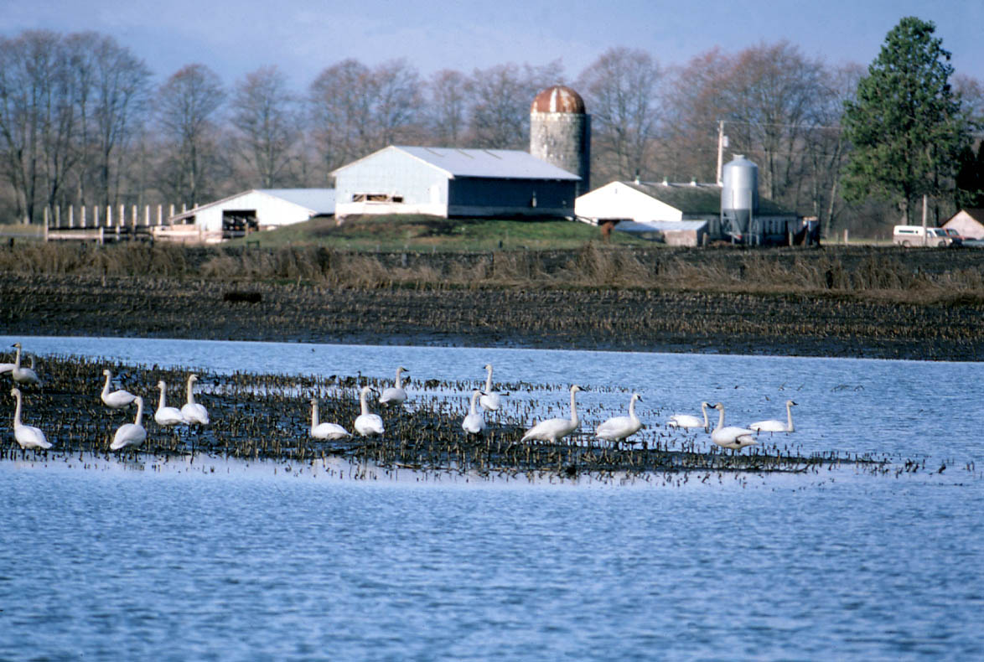
Solutions Step 2 - Interactions
Photo courtesy of Martha Jordan

Slide 30
3 steps in a Modest Proposal: Step 2 - Stimulate Interactions
Leaders in farm, environmental, non-profit groups and agencies step forward to actively promote:
Exchanges of speakers
Newsletter article exchange
Joint public presentations of pro and con
Joint submissions to media
Joint use of membership lists
Trade show booth exchanges
Joint public educational tours
Farm-environmental leader one-on-ones
Maryhill Museum example
Don Stuart
www.donstuart.net

Slide 31
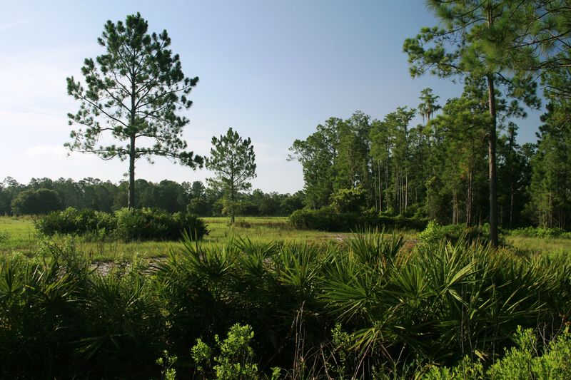
Solutions Step 3 – Public Commitment
Photo courtesy of Marian Ryan

Slide 32
3 steps in a Modest Proposal: Step 3 - Public Commitment to Collaborative Forums
Public agencies and officials support collaborative outcomes on key issues:
Commitment by government to fund and support programs on which agreement can be reached
Financial and other support for the process through to conclusion
Establish clear purposes and goals
Enlist commitments by participants
Don Stuart
www.donstuart.net

Slide 33
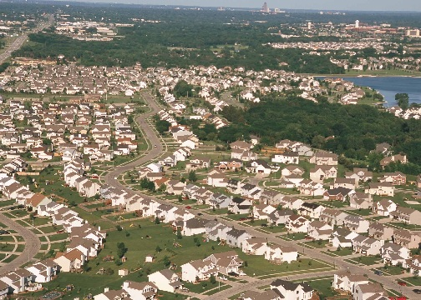
Two Visions of the Future:
Vision One:
Farms and the Environment are Dying
The perspective:
Farms are a temporary or tolerated land use awaiting future development.
The environment is a problem to leave for our children.
Don Stuart
www.donstuart.net
Don Stuart
www.donstuart.net

Slide 34
Two Visions of the Future:
Vision One
Farms and the Environment are Dying
The consequences:
Farmers & Environmentalist continue to fight
Political stalemate continues
No funding for incentives–no action on regulation
Land use controls ineffective–no funding for PDR
Cities sprawl
The environment degrades
Don Stuart
www.donstuart.net
Don Stuart
www.donstuart.net

Slide 35
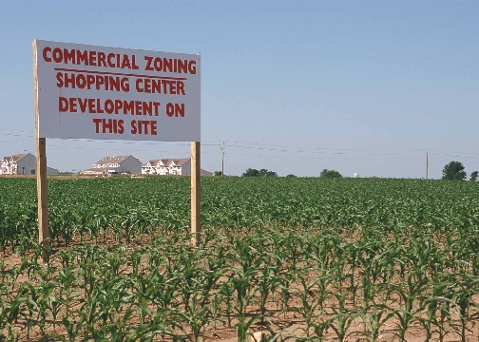
Photo courtesy of USDA/NRCS

Slide 36
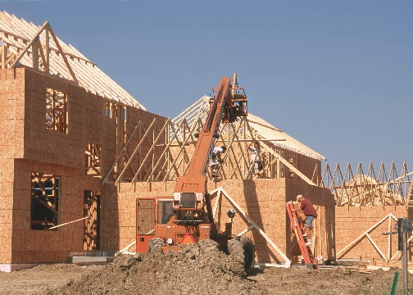
Photo courtesy of USDA/NRCS

Slide 37
Photo courtesy of USDA/NRCS

Slide 38
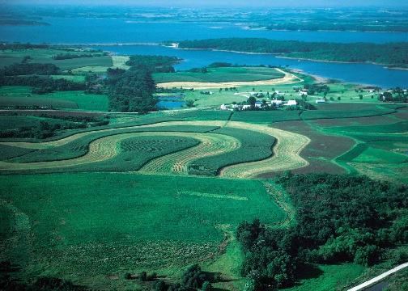
Two Visions of the Future:
Vision Two:
Farms and the Environment are Sustaining
The perspective:
Both farms and the environment must flourish.
Each must mutually reinforce the other if either is to succeed
Don Stuart
www.donstuart.net

Slide 39
Two Visions of the Future:
Vision Two:
Farms and the Environment are Sustaining
The consequences:
Farmers & Environmentalists cooperate
Environmental burdens allocated fairly
Their coalition acquires immense political clout
Public supports both farms and the environment
Sprawl controlled, the environment improves
Agriculture is beloved as a model for a green, responsible industry
Don Stuart
www.donstuart.net

Slide 40
Photo courtesy of USDA/NRCS

Slide 41
Contact information
Don Stuart
Stuart Consulting
www.donstuart.net
dondstuart@gmail.com
Now Available from Washington State University Press and other booksellers: Barnyards and Birkenstocks: Why Farmers and Environmentalists Need Each Other by Don Stuart.

